Slide 1
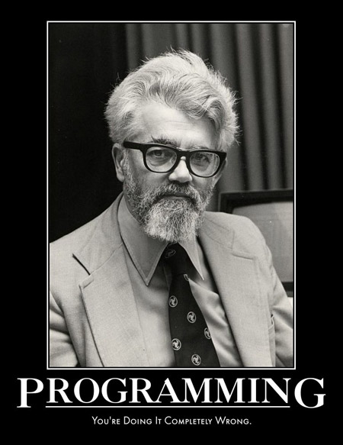
Async and Streaming JS Are We doing it wrong?
Matthew Podwysocki @mattpodwysocki github.com/mattpodwysocki/jsconfeu-2014
Notes:
Hello and welcome to my talk on async and streaming JavaScript, are we doing it wrong? Of course the answer is always going to be yes, else why would I be up here? And what talk about doing it wrong is complete without a picture of John McCarthy, the father of Lisp, telling us so?
Before I get started, I want to thank the organizers, Holger, Jan, Malte, Tiffany and Xenia for doing an awesome job. This is by far one of my favorite conferences, after all, Node.js on Windows might not have happened the way it did without this very conference!

Slide 2
Or "I thought I had a problem. I thought to myself, "I know, I'll solve it with callbacks and events!". have Now problems. two I
Notes:
So, the title once again is Async and Streaming JS, are we doing it wrong? Or, I thought I had a problem and I thought to myself, “I know, I’ll solve it with callbacks and events” have Now problems. two I
Concurrency jokes, they never get old!

Slide 3

Notes:
When talking about these concepts, the last thing I want to do is drag monads into a talk, nor will any category theory be harmed during this presentation. And lastly, no, monads are not like burritos nor any other silly metaphor you can come up with.

Slide 4

Software Engineer Open Sourcerer @mattpodwysocki github.com/mattpodwysocki
Notes:
You might be wondering who I am. Well, I’m a software engineer and self proclaimed open sourcerer. I’m fairly unoriginal in my account names, so chances are if you find me on one, you’ll find me other places.

Slide 5

Notes:
And I work for a small startup, not in the Silicon Valley, but in Redmond, Washington of all places. And I’d like to think that I’m putting the metal back in Microsoft. Yep, adding umlauts to anything makes it more metal!

Slide 6

Rx
@ReactiveX
http://reactivex.io
Notes:
So, I work on a product called the Reactive Extensions, a language neutral approach to asynchronous and event based programming, which oddly enough comes up in this talk.
Click – And yes, I am Matthew Podwysocki and I’m an Rx Pusher.
I’ve been working on the team since 2010, mostly focused on JavaScript and .NET, with a little bit of Ruby, trying to make all languages kick ass. Check out our new website there with all the information forthcoming.

Slide 7
“To be conscious that you are ignorant is a great step to knowledge.”
“Ignorance never settles a question.”
“The best way to become acquainted with a subject is to write a book about it.”
Benjamin Disraeli (1804-1881)
Notes:
To start us on our journey, let’s consider some quotes that will help us on our learning today. They come from the former Prime Minister of the UK, Benjamin Disraeli who has some wise words for us all.

Slide 8
Asynchronous Programming is Annoying
Every library has a different way of doing async/events
Callbacks/Promises are different from events
Each concept covers only part of the story
Wouldn’t it be great to have some concepts to generalize how we think about concurrent/reactive programming?
Notes:
Let’s face it, asynchronous programming is annoying. By themselves, asynchronous and event-based programming is fine as it is per runtime for doing one and only one thing. But they’re ultimately different worlds. Each of these cover its own part, Promises or callbacks for example for single values, and events for multiple values. You wouldn’t use a promise over events that you might expect more than one.
To make this more concrete, say we need to make a web request to get some data, now let’s combine it with some user input from keystrokes which are events. Now, what if we need to then add a timer so we don’t overload the service? How do we do that?
We just worked with three concepts here, promises, events and timers.
So, wouldn’t it be nice to have some unifying concepts over the entire space that we just described?

Slide 9
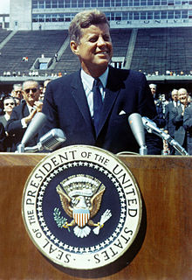
“We choose to go to solve asynchronous programming and do the other things, not because they are easy, but because they are hard”
Former US President John F. Kennedy - 1962
[citation needed]
Notes:
This problem around asynchronous and event-based programming became such a problem that a former US President, who is also known for his speech in which he said “Ich bin ein Berliner”, weighed in. He said we choose to solve asynchronous programming and do other things, not because they are easy, but because they are hard.
Click – citation needed, argh. Thank you Wikipedia!
http://en.wikipedia.org/wiki/We_choose_to_go_to_the_Moon

Slide 10

Callback Hell
function play(movieId, callback) {
var movieTicket, playError,
tryFinish = function () {
if (playError) {
callback(playError);
} else if (movieTicket && player.initialized) {
callback(null, ticket);
}
};
if (!player.initialized) {
player.init(function (error) {
playError = error;
tryFinish();
}
}
authorizeMovie( function (error, ticket) {
playError = error;
movieTicket = ticket;
tryFinish();
});
});
Notes:
As JavaScript developers, we’re very used to callbacks and programming in a continuation passing style. Now callback hell is a very real thing. If you’ve been in the JavaScript world long enough, then you’ve had to deal with trying to do sequential processing of some sort with asynchronous code. Trying to find the logic versus fighting the callback nature, it’s easy to get lost. That and I’m sure there are errors in this code.
What you end up with is what we’ll call a cow’s head, because it kind of has that shape.
Yes, there are websites such as Max Ogden’s awesome site called callback hell, which then tries to solve some of those issues, but ultimately, it’s not a programming model that scales real well.

Slide 11

Notes:
I don’t know about you, but this is my usual reaction to when I’m writing complex code with callbacks. As in the infomercials, there has to be a better way, right?

Slide 12

Events and the Enemy of the State
var isDown = false, state;
function mousedown (e) {
isDown = true;
state = { startX: e.offsetX,
startY: e.offsetY; }
}
function mousemove (e) {
if (!isDown) { return; }
var delta = { endX: e.clientX - state.startX,
endY: e.clienyY - state.startY };
// Now do something with it
}
function mouseup (e) {
isDown = false;
state = null;
}
function dispose() {
elem.removeEventListener('mousedown', mousedown, false);
elem.removeEventListener('mouseup', mouseup, false);
doc.removeEventListener('mousemove', mousemove, false);
}
elem.addEventListener('mousedown', mousedown, false);
elem.addEventListener('mouseup', mouseup, false);
doc.addEventListener('mousemove', mousemove, false);
Notes:
Let’s look at yet another problem most developers face nowadays. Let’s start with a simple example of drag and drop or rather to track Will Smith’s moves in Enemy of the State. We must have a flag as to whether the mouse is down and the state of where the mouse went down. On the mouse move, if the mouse is down, we calculate the delta between the start and now, and then do something with it. Then on mouseup, we clear the state, and set the flag.
We also have to be mindful of not only adding these event listeners, but also removing them once we’re done. That’s a major area on memory leakage in today’s apps.
Not only that, but it’s pretty hostile to adding new behaviors. For example what if I want to add effects or something else? Then I need to dig into the mousemove function, add stuff and hope and pray for the best!

Slide 13

Notes:
What a mess! Can we do better?

Slide 14
The Asynchronous Programming Landscape
Iterable
Observable
var res =
stocks
.filter(q => q.Symbol == "FB")
.map(q => q.Quote)
res.forEach(x =>
...
res =
stocks
.filter(q => q.Symbol == "FB")
.map(q => q.Quote)
res.forEach(x =>
...
Multiple values (*)
Value
Promise
Single value (1)
var y = fAsync.then(x => ...);
var z = gAsync.then(y => ...);
var y = f(x);
var z = g(y);
Synchronous
Asynchronous
Notes:
When I talk about asynchronous programming there are 2 axes that we can look at some of these concepts, single values vs. multiple values, and synchronous vs. asynchronous. You can think of this as a push versus pull kind of world where synchronous is pull and asynchronous is push. And I’d like to talk about thinking with first class objects.
For single synchronous values, we just have a plain old value, could be the result of a function, doesn’t matter.
For multiple synchronous values, we have Iterables in JavaScript. This includes things such as Arrays, Maps, Sets, and even Arguments. Now we should be able to perform high ordered operations on them just as we do with Arrays today.
For a single asynchronous value, we can use a Promise or even a callaback to model that when a value becomes available, it pushes the value to us, or an error, depending on what happened.
For multiple asynchronous values, we can also think of these as collections. An event is a collection of values. So, you could really think that your mouse is a database. Notice there is no difference between the iterable and observable and that’s intentional on our part. If you know synchronous, then you asynchronous.

Slide 15
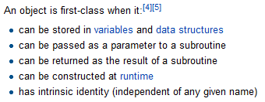

First-Class Async and Events Objects to the rescue
How about a query library?
Or mocking for testing…?
Notes:
The great news is with Promises and Observables , we now have a concept of a first class event. What does that mean? Well, you can take one as an argument, you can return it from a function. What does that buy you exactly?

Slide 16

Promises Promises
promise.then(onFulfilled, onRejected);
Why?
Only one callback will be called either onFulfilled or onRejected
Handlers called asynchronously
If settled, then calls the handlers once attached
player.initialize()
.then(authorizeMovie, loginError)
.then(playMovie, unauthorizedMovie)
Notes:
Promises have started to gain a lot of traction lately. Most major client side libraries such as jQuery, Dojo, and new ones such as Angular, Ember, etc have had these for quite some time (although let’s be real about jQuery promises)… Many great libraries are out there as well including Q, When.js, RSVP and so forth. And now as they’ve been approved for ES6, they’re starting to show up in browsers.
But why are they interesting? Because it provides us a nice simple linear path for handling async programming. Not only that, but it also allows for us to run the computations in parallel and a lot of other opportunities. Unlike callbacks, these promises can be passed around and treated as first class citizens.

Slide 17
Promises Promises
Problems in Promiseland
How do I handle cancellation?
What if I don’t care about the return value ala Autocomplete?
var promise;
input.addEventListener('keyup', function (e) {
if (promise) {
// Um, how do I cancel?
} else {
promise = getData(e.target.value).then(populateUI);
}
}, false);
Notes:
But at least I’ve had some problems with promises. Promises are pretty straight forward, however, they don’t account for some use cases that appear to me quite often. For example, how do I handle cancellation? Should I subclass a Promise and make a cancellable one? If so, do I cancel it for the current user, or cancel it for everyone?
Or better yet, what if I get to a certain point and I don’t care about the return value, akin to an autocomplete example?
Yes, there are such discussions such as a cancellable promises spec from Domenic Denicola, as well as the last library which allows you to listen to only the last. Are there patterns we can learn here?

Slide 18
Reactive Programming http://www.reactivemanifesto.org
Merriam-Webster defines reactive as “readily responsive to a stimulus”, i.e. its components are “active” and always ready to receive events. This definition captures the essence of reactive applications, focusing on systems that:
react to events
the event-driven nature enables the following qualities
react to load
focus on scalability by avoiding contention on shared resources
react to failure
build resilient systems with the ability to recover at all levels
react to users
honor response time guarantees regardless of load
Notes:
So, there has been a big buzz around Reactive Programming Lately, and I think partially due to the popularity of the Reactive Extensions. That and the Coursera Course of Reactive Programming came out. How many people did that course? How many actually finished it? Well, you’re all Reactive Programmers now!
The Reactive Manifesto was a document that came out to try and define what exactly reactive programming is. Much like a lot of things like Functional Programming where it’s kind of fuzzy as to what it truly means to be a functional language. Here at least we break it down to its essentials, as in “readily responsive to a stimulus.
It’s broken into four parts,
1: Reacts to Events, so, event driven
2: Reacts to loads, meaning it can somehow deal with load as it comes through
3: React to failure, so, some sort of compensation logic
4: Finally react to users. Give them something timely without locking up the application
That’s it. That’s all you need to know. When we’re going to talk about Reactive Programming here, we’re going to talk about the general concept of Observables.

Slide 19

Observables - Querying UI Events
var mousedrag = mousedown.flatMap(function (md) {
// calculate offsets when mouse down
var startX = md.offsetX,
startY = md.offsetY;
});
1
For each mouse down
Notes:
This example is in JavaScript, and we can get our event handlers using a bridge library to Angular, jQuery, Dojo, MooTools, even plain old HTML, we have a plugin for that.
We can start off by taking the mouse down events and calling flatMap which is essentially mapping each value to a set of values and then flattening it, so you don’t end up with a sequence of sequences. Then we can start by getting the starting position for later usage.

Slide 20
Observables - Querying UI Events
var mousedrag = mousedown.flatMap(function (md) {
// calculate offsets when mouse down
var startX = md.offsetX,
startY = md.offsetY;
// calculate diffs until mouse up
return mousemove.map(function (mm) {
return {
left: mm.clientX - startX,
top: mm.clientY - startY
};
})
});
1
For each mouse down
2
Take mouse moves
Notes:
Now what we’re going to do is then take the mouse movements and map them so that we calculate the offsets between the starting location when the mouse button went down and when the mouse began to move, so that we could reposition our image to the new location.
Now, how do we stop listening? You stop when the mouse goes up

Slide 21
Observables - Querying UI Events
var mousedrag = mousedown.flatMap(function (md) {
// calculate offsets when mouse down
var startX = md.offsetX,
startY = md.offsetY;
// calculate diffs until mouse up
return mousemove.map(function (mm) {
return {
left: mm.clientX - startX,
top: mm.clientY - startY
};
}).takeUntil(mouseup);
});
1
For each mouse down
2
Take mouse moves
3
until mouse up
Notes:
We can get that exact behavior that we’re looking for by using the takeUntil operator which stops the sequence when another observable sequence fires.
Now we can easily say that mouse drag is really just mouse down and mouse move until mouse up, which is exactly what we’re showing here. Not only that, but when we subscribe, we add event handlers to the events, and when we dispose, we remove all event handlers automatically.

Slide 22

Observables - Composing Events and Promises
DOM events as a sequence of strings
var words = Rx.DOM.keyup(input)
.map(function() { return input.value; })
.throttle(500)
.distinctUntilChanged()
.flatMapLatest( function(term) { return search(term); } );
words.subscribe(function(data) {
// Bind data to the UI
});
Reducing data traffic / volume
Latest response as word arrays
Web service call returns single value sequence
Binding results to the UI
Notes:
Now let’s take a look at a more interesting example. What if we could seamlessly integrate Promises and Observables together to do an autocomplete scenario? How would that work?
Well, what we can do is get the keyup first class event, then map it to get the current value of the text box. First and foremost, we don’t want to overload the server with too many requests at once, because bandwidth is money. So, we can throttle it by half a second to ensure we stop typing that long, and then we want to make sure we’re only sending over distinct data.
Next we need to take the throttled input and query the service which may return a Promise. Proper handling of asynchronous behavior is important and order matters. If I type react then type reactive, yet reactive comes back first, we don’t want to have the result from our first request to clobber the results from our last. That’s a typical mistake I see in a lot of applications. To fix that, we call flatMapLatest in which your map function returns an observable of observables and then flatMapLatest cancels all previous requests and only returns the latest value.

Slide 23
Observables - Polling for Row Updates
function getRowUpdates(row) {
var scrolls = Rx.DOM.scroll(document);
var rowVisibilities =
scrolls.throttle(50)
.map(function (scrollEvent) { return row.isVisible(scrollEvent.offset); })
.distinctUntilChanged()
.publish().refCount();
var rowShows = rowVisibilities.filter(function (v) { return v; });
var rowHides = rowVisibilities.filter(function (v) { return !v) });
return rowShows
.flatMap(Rx.Observable.interval(10))
.flatMap(function () { return row.getRowData().takeUntil(rowHides); })
.toArray();
};
Notes:
So, how do we poll for updates on the client based upon scrolling?
We start off by getting the scrolls, then we get the row visibilities, throttling it just a little bit so that we’re not firing it too many times, then we’re going to determine whether the row is visible, make sure it’s distinct (meaning true/false), and then share it out to the world.
We can then create rowShows and rowHides streams based upon whether it is visible or not.
Now, it’s just simple composition, take the row shows, chain it to an interval of 10 ms, then chain it to getting the row data, until the row is hidden. Finally, returning it all as an Observable of an array.

Slide 24

Notes:
It leads you to a zen-like moment that indeed everything is a stream…

Slide 25
Functional Reactive Programming (FRP) is…
A concept consisting of
Continuous Time
Behaviors: Values over time
Events: Discrete phenomena with a value and a time
Compositional behavior for behavior and events
What it is not
High order functions on events like map, filter, reduce
Most so-called FRP libraries out there…
http://stackoverflow.com/questions/1028250/what-is-functional-reactive-programming
Notes:
Function Reactive Programming you may have heard a lot about recently. So, what exactly is it? First off, it has a notion of continuous time.
First part is a notion of behaviors, which is to say values over time. A clock is a perfect example of that, as it has a notion of a current time, and it is always moving.
The second notion is a discrete event, think something like a mouse click. It doesn’t really have a value per se, but when it happens, it yields a value and a timestamp.
What is it not?
First off, it’s not just high order operators on events like map, filter, reduce, and I’d say a good majority of the libraries that say they are FRP, are really not.

Slide 26
Notes:
Let’s take a look at generators next. Could they solve some of our asynchronous problems?

Slide 27
Generators
Coming to a runtime near you!
Yield suspends the execution of the function
A number of libraries support this like co, Q, and even RxJS
var Rx = require('rx');
var request = require('request');
var get = Rx.Observable.fromNodeCallback(request);
Rx.spawn(function* () {
var a = yield get('http://localhost/stocks1.csv').retry(3);
console.log(a.length);
});
Notes:
Generators are an ES6 feature which allows you to suspend the execution inside a function by yielding a value and then resuming once the value has been consumed. This is great for normal pull based iteration, but you could imagine behind the scenes for example that you can make yield handle callbacks, promises or even observables? It’s not too hard and some libraries are doing it such as co, Q, and yes even RxJS (coming soon).

Slide 28
Communicating Sequential Processes (CSP)
Originally from C.A.R Hoare
Concurrency model for Clojure and Go languages
Generators make this a much easier win
var ch = chan();
go( function* () {
var val;
while ((val =
yield take(ch)) !== csp.CLOSED) {
console.log(val);
}
});
go( function*() {
yield put(ch, 1);
yield take(timeout(1000));
yield put(ch, 2);
ch.close();
});
https://github.com/jlongster/js-csp
Notes:
CSP is a rather old style of concurrency, created by Tony Hoare, now at Microsoft Research. This style, which involves channels in which you can put, take, alternate data. Go with go-routines and Clojure with core.async have adopted this style of concurrency. In JavaScript, such libraries as js-csp

Slide 29
Notes:
Me personally? I’m not a fan. It doesn’t work for me. Error handling is very manual, as is the disposal of resources, such as event handlers. I find that more functional programming style fits my programming needs.

Slide 30

Notes:
That’s great that we have generators and yield, but to me, it’s rather ugly, isn’t it? Could we instead have an async/await style of programming to make it explicit for asynchronous programming?

Slide 31
Async/Await
Coming to a JavaScript Engine Near You!
Adds async and await keywords for Promises
Accepted into Stage 1 of ECMAScript 7 in January 2014
async function chainAnimationsAsync(elem, animations) {
var ret = null;
try {
for (var anim of animations) {
ret = await anim(elem);
}
} catch (e) { /* ignore and keep going */ }
return ret;
}
https://github.com/lukehoban/ecmascript-asyncawait
Notes:
And the answer is yes. Luke Hoban proposed async/await for JavaScript and was accepted into Stage 1 for ES7. This will currently work over promises or promise like contracts. Suddenly, our contract looks a bit nicer as it’s explicit that it’s an async function.

Slide 32

Notes:
We’ve talked about promises, observables and generators can do for us, what about stream processing?

Slide 33


Let’s Face it, Streams1 were terrible…
The pause method didn’t
The ‘data’ event started immediately, ready or not!
Can’t just consume a specified number of bytes
Pause and resume were impossible to get right…
Notes:
When streams come to mind, what’s the first thing people think of? Probably Node. In the early days, however, all was not well in streams land, in fact they were pretty terrible.
What you ended up with was something like this: click
Node Streams 1
http://nodejs.org/docs/v0.11.5/api/stream.html#stream_compatibility_with_older_node_versions
https://github.com/substack/stream-handbook
https://www.exponential.io/blog/nodeday-2014-state-of-node
http://strongloop.com/strongblog/practical-examples-of-the-new-node-js-streams-api/
http://blog.nodejs.org/2012/12/20/streams2/

Slide 34

Streams2 Electric Boogaloo
Landed in 0.9.4
Now supported “Object Mode”
Flowing mode versus non-flowing mode
Introduced the following Streams classes:
Readable
Writable
Duplex
Passthrough
Streams 33 1/3
Landed in 0.11.2
Adds cork/uncork/_writev
Notes:
Streams2 came to the world and there was much rejoicing which went into the stable version 0.10. It could now support normal objects, if you cared to do such a thing. They also introduced a flowing versus non-flowing mode which then helped with incremental reads, pausing and resuming. And to make it a bit easier, they split out the streams into their own classes based upon what they were supposed to do.
Then Streams 3 comes along, which I’m sure will go stable any minute now, which adds cork, uncork and _writev which basically allows for batched writes, which cuts down on some of the system calls.

Slide 35

WHATWG Streams
Specification for creating, composing and consuming streams of data
Currently in draft
Focused on low-level I/O, not on object mode
Unicast in nature only
Follows Node.js style streams but with Promises
Readable
Writable
https://whatwg.github.io/streams/
Notes:
Now the WHATWG, through Domenic Denicola, is proposing the same kind of thing for the browsers as well. Much like Node streams, they are mainly I/O focused and unicast in nature, one way in, one way out.
What if instead of just looking at low-level I/O, let’s look at the bigger picture. What’s the more general idea underlying this kind of thing, that goes beyond I/O to encompass things like first-class events?

Slide 36

Asynchronous Programming with Futures and Streams
Futures are like JavaScript Promises
Streams unify I/O and events
Mirrors Rx by adding map/filter/reduce, etc
Stream<List<int>> stream = new File('quotes.txt').openRead();
stream.transform(UTF8.decoder).listen(print);
querySelector('#myButton').onClick.listen((_) => print('Click.'));
https://api.dartlang.org/apidocs/channels/stable/dartdoc-viewer/dart-async
Notes:
Oddly enough, the Dart language did just that, by implementing Futures and Streams into their async library. Their streams both support file I/O, but also first class events. Their design was heavily inspired by some of our work on the Reactive Extensions.

Slide 37
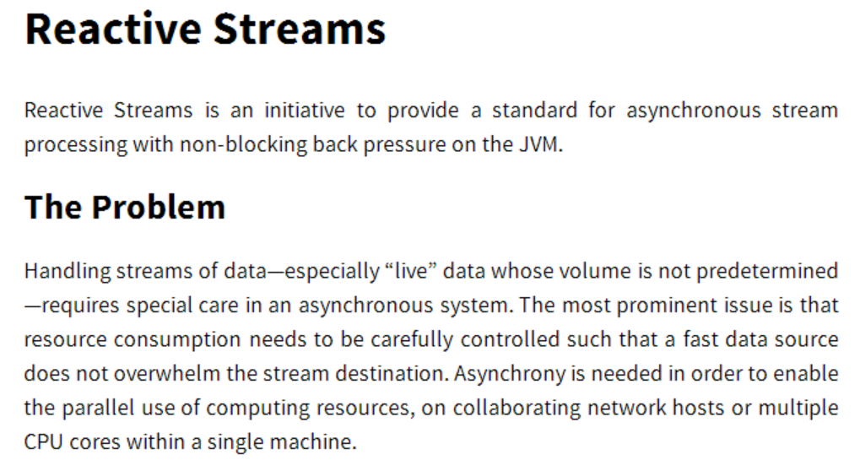
http://www.reactive-streams.org/
Notes:
Could systems such as Observables handle backpressure? Good question. The Reactive Streams effort is an effort to bring a common backpressure mechanism to streams. And guess what, we’re also involved.

Slide 38
Observables and Backpressure
Yes, Observables can have backpressure
Can be lossy (pausable, sample, throttle)
Can be lossless (buffer, pausableBuffered, controlled)
Will be built into the subscriptions starting in 2.4
var pausable = chattyObservable.pausableBuffered();
pausable.pause();
pausable.resume();
var subscription = chattyObservable.subscribe(print);
subscription.request(10);
Notes:
The term backpressure means a lot of things, you can either apply lossy or lossless ways of handling when the producer becomes too chatty. Rx Observables support this through operators, and come version 2.4, we will be implementing implementing reactive streams in JavaScript with RxJS.

Slide 39
Where do we go from here?
ES7 and Beyond!
First class events FTW!
Async Generators!
async function* getDrags(element) {
for (let mouseDown on element.mouseDowns) {
for (let mouseMove on
document.mouseMoves.takeUntil(document.mouseUps)) {
yield mouseMove;
}
}
}
http://esdiscuss.org/notes/2014-06/async%20generators.pdf
Notes:
Looking ahead, what else can we do? Where can we grow? There is an effort underway by Jafar Husain from Netflix on TC39, the ECMAScript standardization committee, for async generators, the idea that we can treat async operations or events as first class iterables. How cool would that be?

Slide 40
Matthew Podwysocki @mattpodwysocki github.com/mattpodwysocki/jsconfeu-2014
Notes:
Hopefully I gave you enough to think about when it comes to asynchronous and event-based programming to expand your horizons beyond callbacks and events. I’d to chat with you about it afterwards.
Oh, and one more thing, if anyone wants an Rx sticker, come see me!

